Slide 1
RESTAURANT CASTLE
Supervised by:-Avranil Tah
Submitted by:-
ABHIJIT MALLICK
KUMARI SUSHMITA RANI
MALAY SARKAR
MAYANK MISRA

Slide 2
INDEX
1.Introduction
2.Technologies used
3.ER Diagrams
4.Project Demonstration
5.Conclusion

Slide 3
INTRODUCTION
Restaurant Castle.com is a restaurant search and discovery service. It automates the business process, manages data, and makes the work easier for customers and restaurants specially for the ones who don’t have their own website.
By selecting the location of your choice you can get the list of restaurants with their respective menu and price. It is easy to use and saves time. It is a foodie’s heaven and the best thing is that you can compare several restaurants and their price anywhere.

Slide 4
Technologies used:-
The project has been developed with the help of the following technologies:-
Hyper Text Mark-up language(HTML)
Java Server Pages(JSP)
MYSQL
Net Beans 8.2

Slide 5
ER-DIAGRAM 1:
res_name
rating
search_res
loc

Slide 6
ER-DIAGRAM 2:
res_name
price
speciality
cuisine

Slide 7
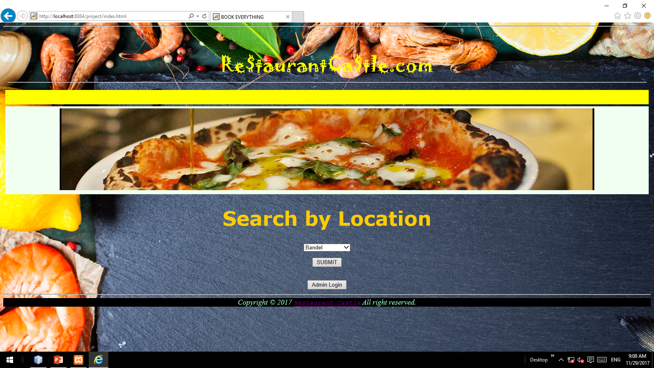
HOMEPAGE:

Slide 8
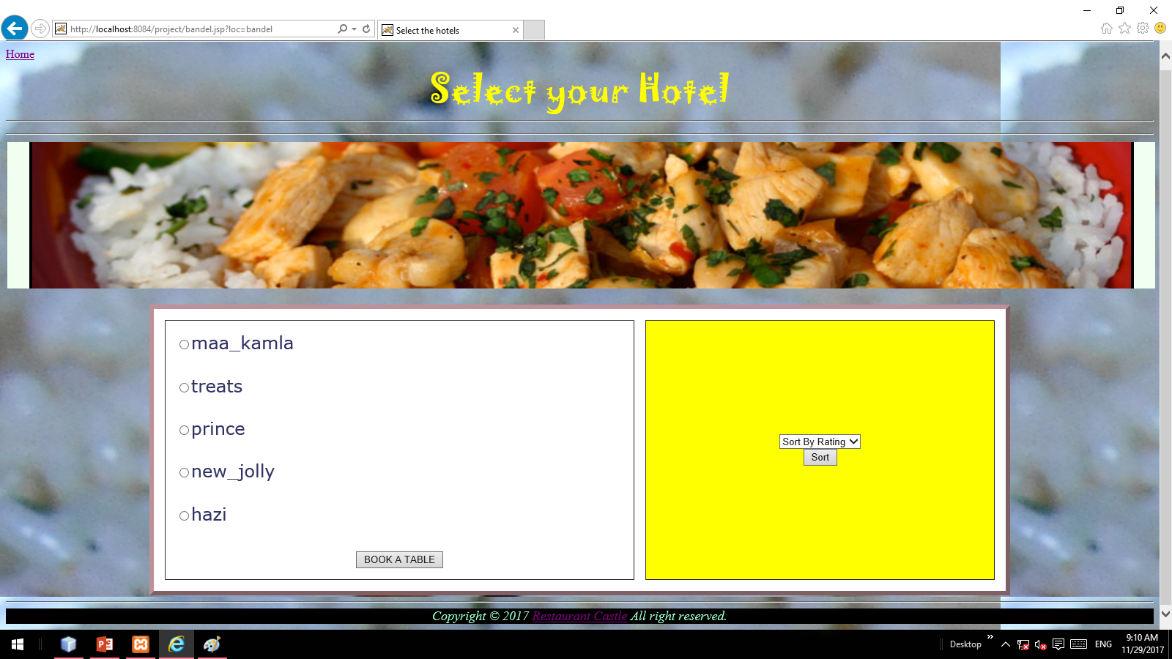
SELECT HOTEL :

Slide 9
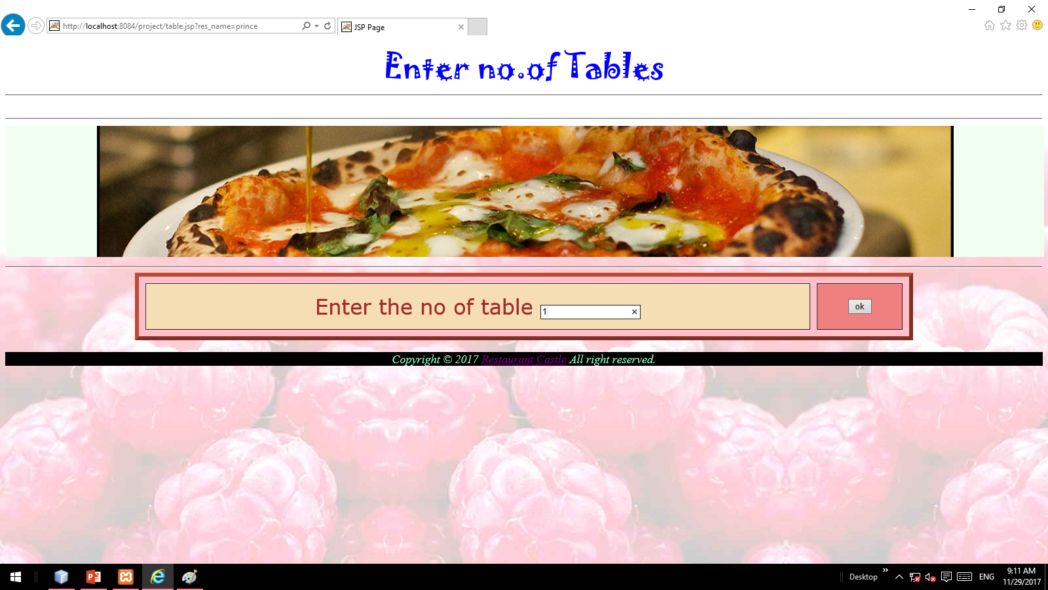
ENTER NO.OF TABLE:

Slide 10
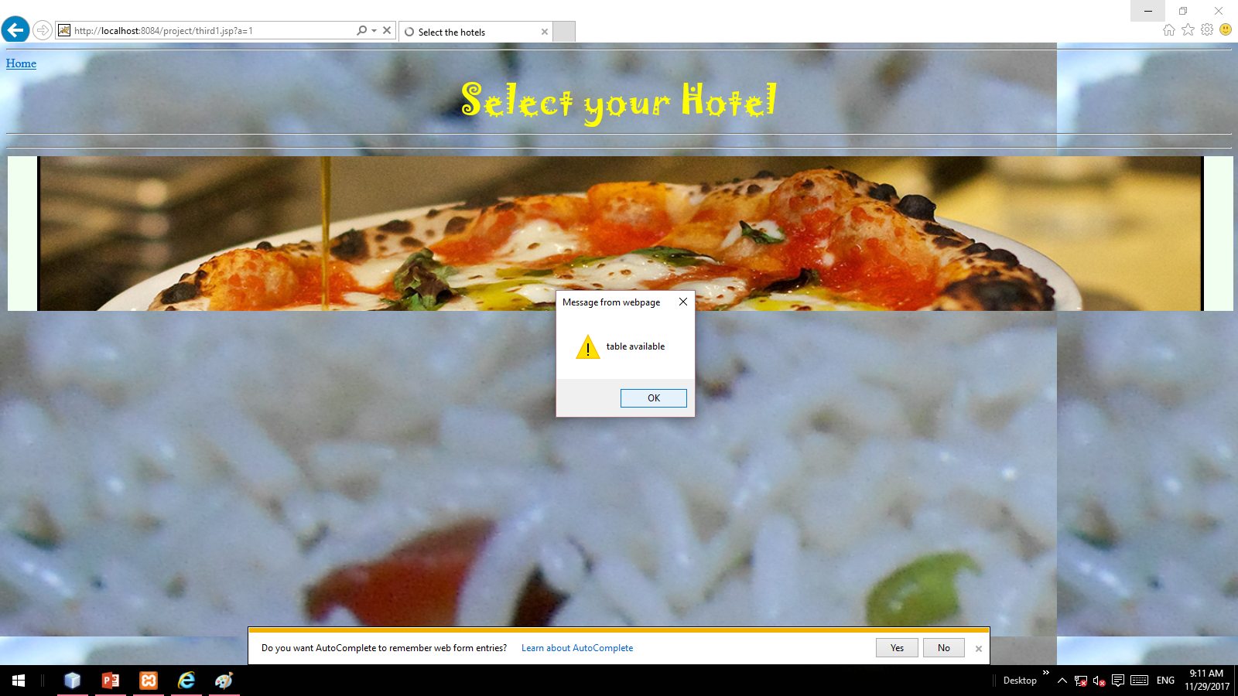
TABLE AVAILABLE POPUP

Slide 11
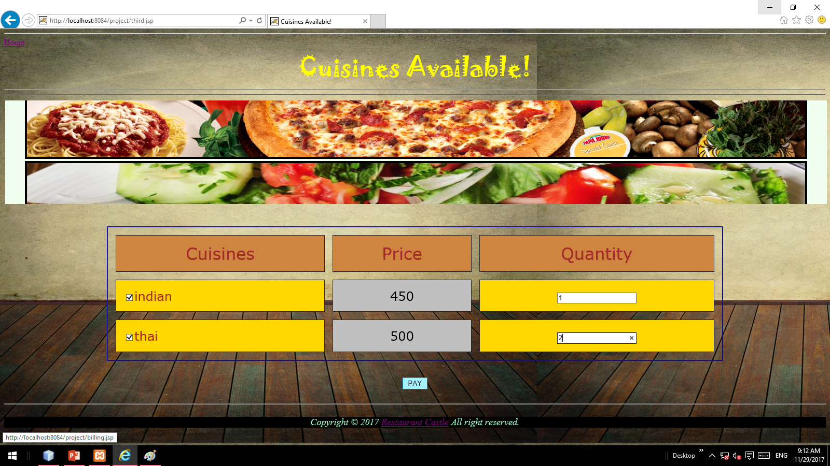
CUISINES AVAILABLE :

Slide 12
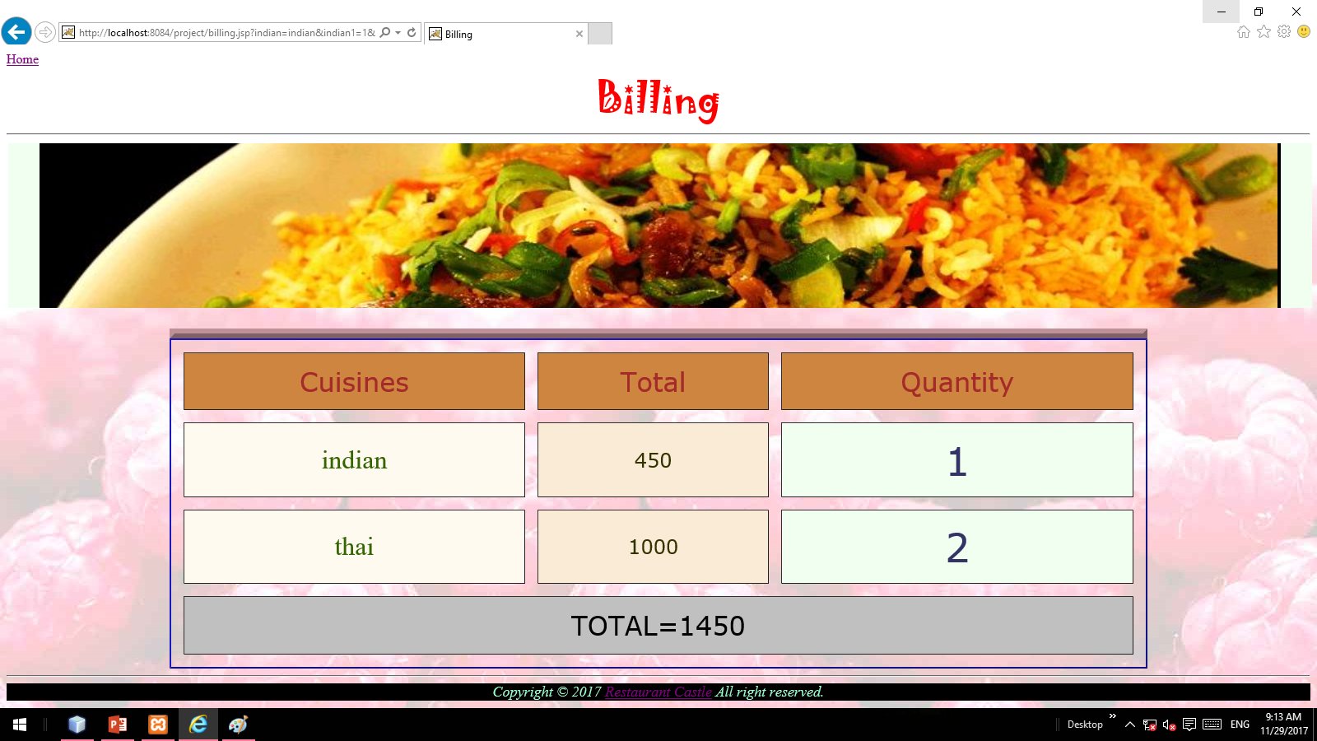
BILING :

Slide 13
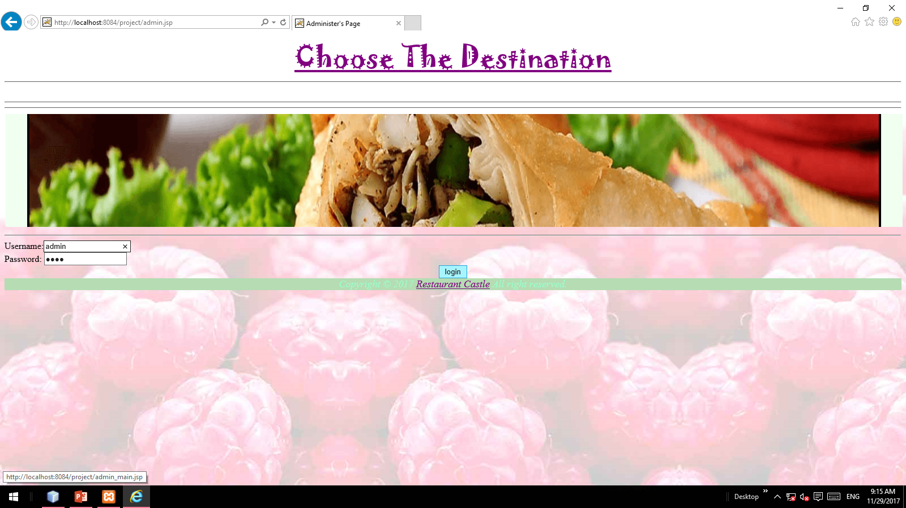
ADMIN PAGE:

Slide 14
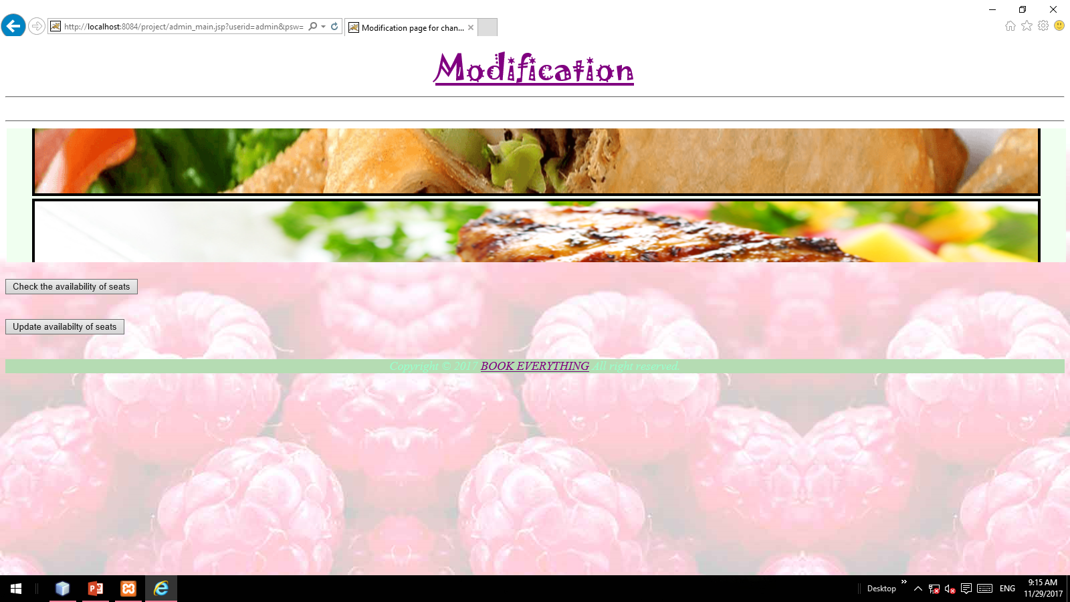
MODIFICATION:

Slide 15
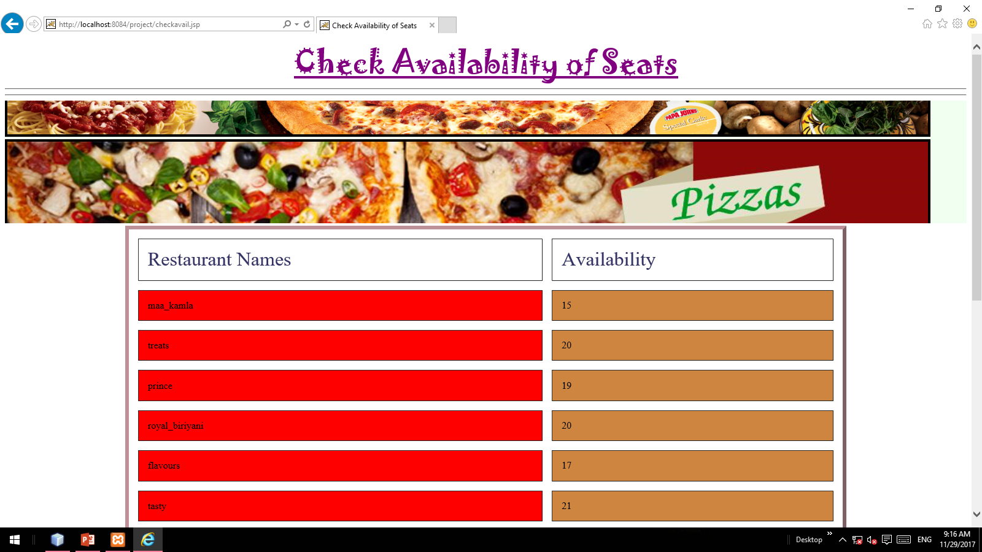
AVAILABILITY:

Slide 16
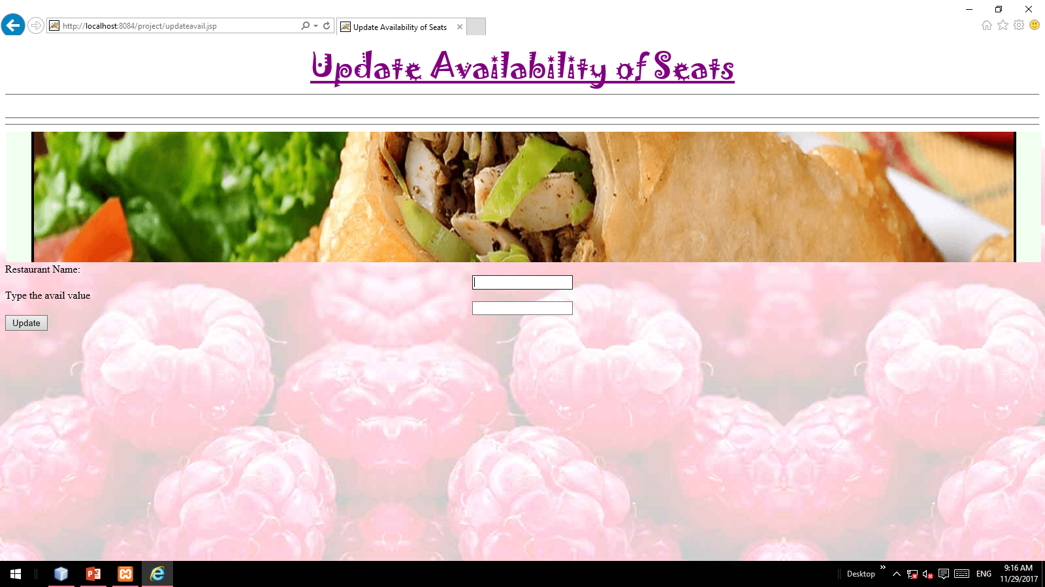
UPDATION:

Slide 17
CONCLUSION:
At the end, we conclude that our project is very much reliable both for the customers as well as restaurant owners. The data can be updated anytime easily as the records are maintained electronically. It is very efficient, useful and effective.
We are constantly working for upgrading our project and introducing the upcoming restaurants and providing their ratings. And we are constantly working for adding further services.

Slide 18

Thank You!

